Slide 1
Using polling and demographic data to predict presidential elections with machine learning techniques
Ronan Tegerdine

Slide 2
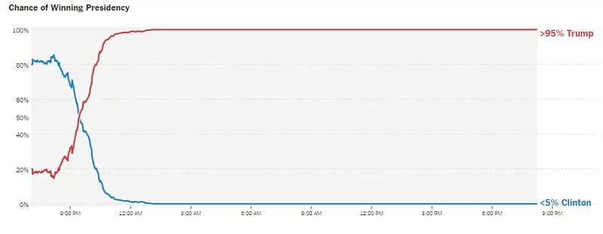
Elections
Elections have always been tough to predict… even now

Slide 3
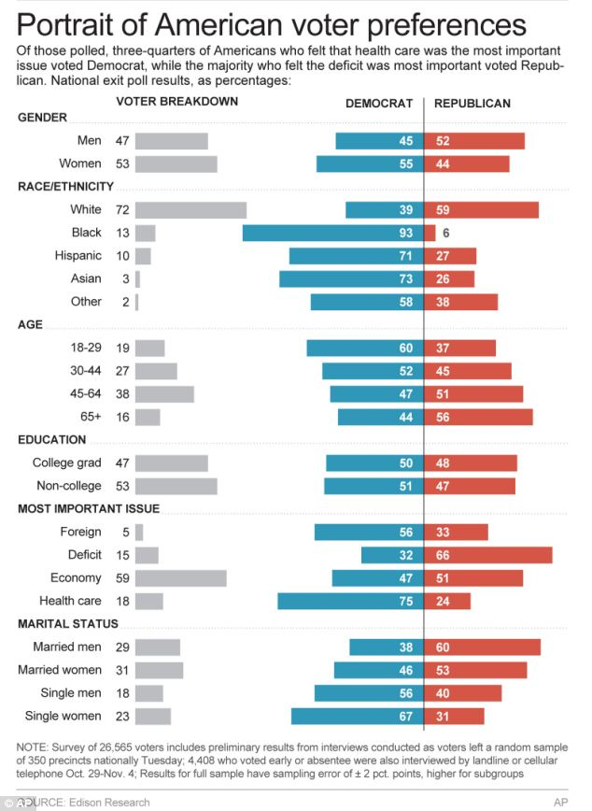
Factors
What factors affect how people vote?
Race
Religion
Ethnicity
Income
Unemployment
Education
Past behavior
Polling
Why does it matter?

Slide 4
Previous research
Demographic and economic data
Machine learning
Linear regressions
Bayesian statistics
Model ensembling
State vs national

Slide 5
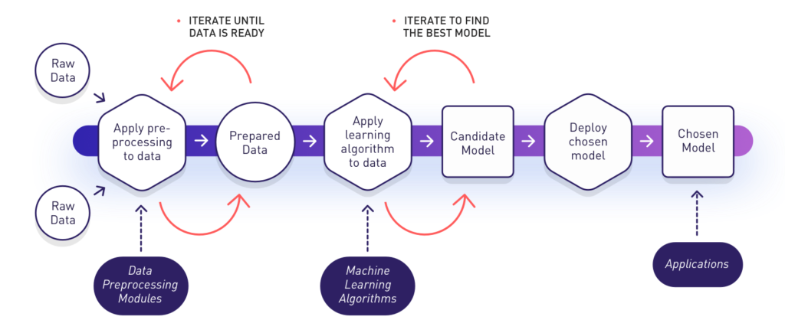
Machine learning
Using computers and large amounts of data to create models
Non-linear relationships, complex patterns

Slide 6
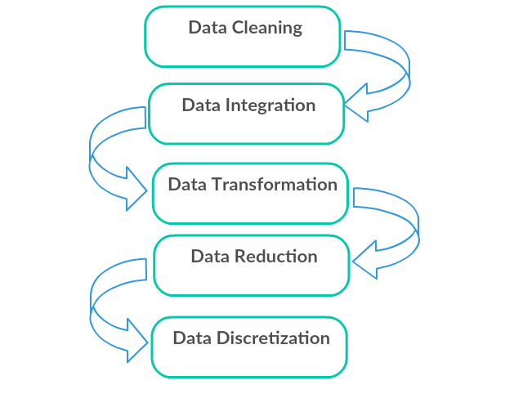
Data and preprocessing
Data source- 538, polls, USDA atlas
Different datasets will be produced
Feature engineering
Visualization
Imputing
Scaling
PCA

Slide 7
Combining factors
Economic changes over a term affect voting, current political power
Swing model formation
Other variables are more predictive
Prediction model

Slide 8
Model creation
Multiple algorithms to choose
Gradient boosting
Tree models(random forest)
Logistic regression
SVM
Neural networks

Slide 9


Slide 10
Optimization
Hyperparameters
Grid search, random search
Some models are inherently better for some datasets than others

Slide 11
Ensembling
Combine predictions of two models
Test different weights
Different data, different model architectures, different results

Slide 12
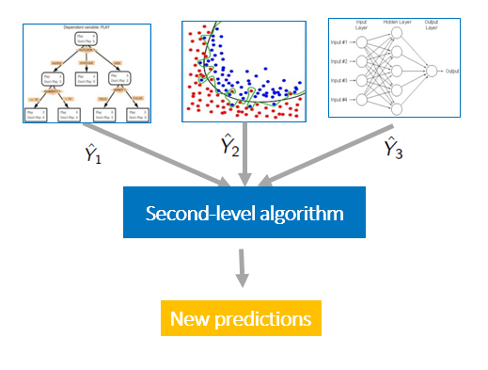
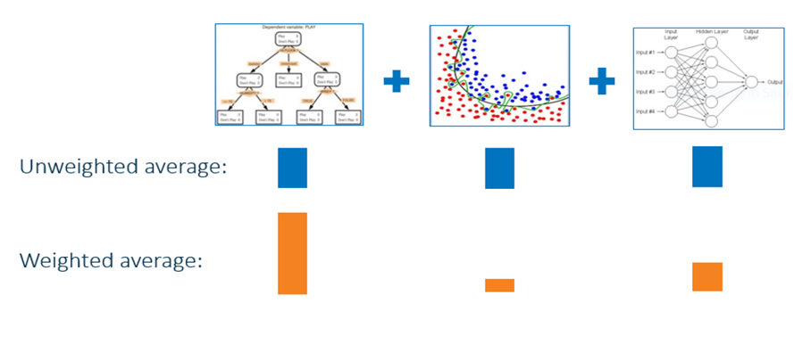
Ensemble diagram

Slide 13
Overall workflow
Data collection
Data preprocessing
Prediction model creation
Swing model creation
Ensembling model
Pollsters, 538
Visualization, imputation
Demographic and polling data
Approval ratings, economic conditions
Adjusting biases and optimization
Census, USDA atlas
Scaling and PCA, revisualization
Model optimization, architectures, dataset testing.
Model optimization, architectures, dataset testing.
Final results and predictions

Slide 14
Questions

